Slide 1
Object Oriented Development
Week 1 – Programming

Slide 2
Lecturer Details
Malsha Fernando
Senior Lecturer + Level Coordinator
MSc in Computer Science (UK)
PgD in IT (UCSC)
BSc in MIS (Ireland)
12+ years experience in academia
Programming in Java, DBMS, Data Structures and Algorithms, Mobile Computing, NLP, Software Design, etc.
Email: malsha.f@iit.ac.lk
WhatsApp 0740380494

Slide 3
Lecture 1 Learning Outcomes
Module learning outcomes and objectives
Module content
Assessment criteria
The object orient concept – an introduction
Encapsulation
Inheritance
Polymorphism
Abstraction
Class and object

Slide 4
Module Learning Outcomes
In this module you will learn how to;
Analyze a programming task using OO concepts
Design software using UML diagrams associated with OO concepts
Engineer software guided by UML diagrams and including advanced OO constructs
Implement and evaluate an OO software artefact for a given real-world programming problem

Slide 5
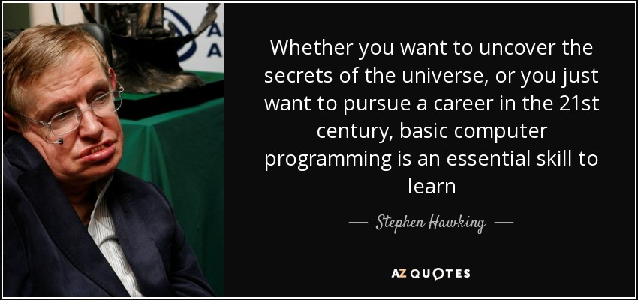
Something to think about!
Notes:
English theoretical physicist whose theory of exploding black holes drew upon both relativity theory and quantum mechanics.
Stephen Hawking's contributions to the understanding of gravity, black holes and cosmology were truly immense.

Slide 6
Module Content
Classes and objects:
attributes and operations,
constructors,
access specifiers and non-access specifiers,
return types.
Object oriented programming principles:
abstraction,
encapsulation,
inheritance and polymorphism,
abstract classes and interfaces.
I/O streams and file handling.
Advanced programming features:
exception-handling mechanisms,
concurrent programming mechanisms.
Object oriented design principles and patterns using suitable modelling tools.
Version control Standards and Best Practice Guides,
Database Connectivity.
Notes:
The Java API is the set of classes included with the Java Development Environment. These classes are written using the Java language and run on the JVM. The Java API includes everything from collection classes to GUI classes.

Slide 7
Objectives of the course
Resolve more complicated programming problems
Decompose programming problems using object-oriented analysis and design
Apply object-oriented programming concepts when writing programs
Improve the knowledge and skill of manipulating Java programming language

Slide 8

Assessment
NO EXTENSIONS!!!
Group Coursework
50%
LO 3 & 4
Submission Deadline – End of the semester (week 10)
Viva will be held within 2 weeks of the submission
Closed Book Examination
50%
LO 1 & 2
Will be held in January exam week

Slide 9


Plagiarism and Academic Misconduct
“Plagiarism is presenting someone else’s work or ideas as your own, with or without their consent, by incorporating it into your work without full acknowledgement”
Plagiarism | University of Oxford. (n.d.). Retrieved September 27, 2022, from https://www.ox.ac.uk/students/academic/guidance/skills/plagiarism

Slide 10

Plagiarism and Academic Misconduct
“All published and unpublished material, whether in manuscript, printed or electronic form, is covered under this definition.
Plagiarism may be intentional or reckless, or unintentional. Under the regulations for examinations, intentional or reckless plagiarism is a disciplinary offence.”
Plagiarism | University of Oxford. (n.d.). Retrieved September 27, 2022, from https://www.ox.ac.uk/students/academic/guidance/skills/plagiarism
Notes:
Do not copy the code from other students
Do not copy the code from external source
You will be asked to demonstrate the understanding of your work

Slide 11
Books and resources
Liang, Y. D. 2017. Introduction to Java Programming and Data Structures, Comprehensive Version. 11th ed. Pearson.
Deitel, P. and Deitel, H. 2017. Java How to Program, Early Objects. 11th ed. Prentice Hall. 4 Sommerville, I. 2015.
Horstmann, C. 2013. Big Java: Late Objects. 1st ed. John Wiley.
Sommerville, I. 2015. Software Engineering. 10th ed. Pearson.

Slide 12
Your Contribution
Be punctual
Regular attendance
No distractions in class (mobile phone, electronic devices, etc.)
Complete the tutorials, gapped handouts and exercises
Take notes
Ask questions and clear your doubts
Follow the deadlines
and most importantly………..

Slide 13
Programming is a “skill”
best acquired
by practice and example
rather than from books!
Notes:
Even if you will not become a professional programmer, learning programming is a valuable life skill.
It involves:
creativity: programming involves problem solving skills...
systematic thinking: programming teaches you to reason logically and consequently…
collaborative work: coding within a team...

Slide 14


Procedural Vs Object Oriented Programming
Customer, Bank,
Account
Withdraw, Deposit,
Transfer

Slide 15
Object Oriented Programming
Examples?
Data
Behaviors
Notes:
Object = Any entity – Living or non living

Slide 16
Object Oriented Programming
Real World
Analyze + Design
Model
Coding
Program

Slide 17
Object Oriented Programming
A program typically creates a model of a part of the “real” world
The parts of the model are the objects that can be identified in the problem, and these will be included in the software model (done using design principles)

Slide 18
Object Oriented Programming
Objects can be categorized into classes
All objects that share similar characteristics or behaviors, that are of the same kind, belong to the same class
An object that belongs to a class is an instance of this class

Slide 19


An example of an OO model
Objects
Andy
Apples
Book
Interactions/ Relationships
Andy eats Apples
Andy reads Books

Slide 20
Why OO?
People think in terms of objects
OO models map to reality
Therefore, OO models are
easy to develop
easy to understand

Slide 21

An Object – Example 1
Person Object
Name = “Sam”
Age = 22
walk()
eat()
sleep()
Notes:
How many can be there?
Something tangible (person, pen, mug)
Something that can be apprehended intellectually (Time, Date)
An object has state, behavior, identity

Slide 22

An Object – Example 2
Dog Object
Name = “Mickey”
Age = 2
Breed = “Labrador”
bark()
eat()
sleep()
Notes:
How many can be there?
Something tangible (person, pen, mug)
Something that can be apprehended intellectually (Time, Date)
An object has state, behavior, identity

Slide 23
Class
Class – Person
Data/ Attributes
Can you identify more??
Name
Age
Behaviors/ Methods
walk()
eat()
sleep()

Slide 24
Exercise
Can you identify attributes and behaviors of Dog class.

Slide 25
Principles of OO
Encapsulation
Inheritance
Polymorphism
Abstraction

Slide 26
Summary
Module introduction
Assessments
Procedural Vs OOP
Classes and Objects
OO Principles

Slide 27
Next
Design a class
OO Principles
Encapsulation
Inheritance
Abstraction
Polymorphism

